Slide 1

Credit Card Fraud Detection SYSTEM
CS 584: Machine Learning:
Group no: 51
Team Members:
Manavkumar Patel (A20543097)
Nitesha Paatil (A20544932)
Prof: Yan Yan

Slide 2

INTRODUCTION
Surge in online transactions has resulted to an increase in credit card fraud
Effective fraud detection is essential to shield clients from monetary losses and unauthorized transactions
Every year, credit card fraud costs billions and affects both consumers and businesses
Machine learning algorithms can provide solutions to combat credit card frauds by analyzing large datasets to detect fraud patterns
Unauthorized purchases are avoided, and default risks are decreased by early fraud detection
This highlights the critical need to invent trustworthy or reliable techniques to lower credit card fraud in online purchases

Slide 3

PROBLEM STATEMENT
3
Due to the increase in e-commerce, credit card fraud, making the development of effective fraud detection systems necessary to reduce losses for both financial institutions and consumers.

Slide 4


ALGORITHMS USED
Implemented multiple machine learning algorithms for credit card fraud detection:
Logistic Regression
AdaBoost Classifier
Random Forest
Decision Tree
Linear Discriminant Analysis
Naive Bayes Classifier
XGBoost Classifier
Evaluated the performance of each algorithm
Random Forest was selected as the most accurate model for the given application

Slide 5
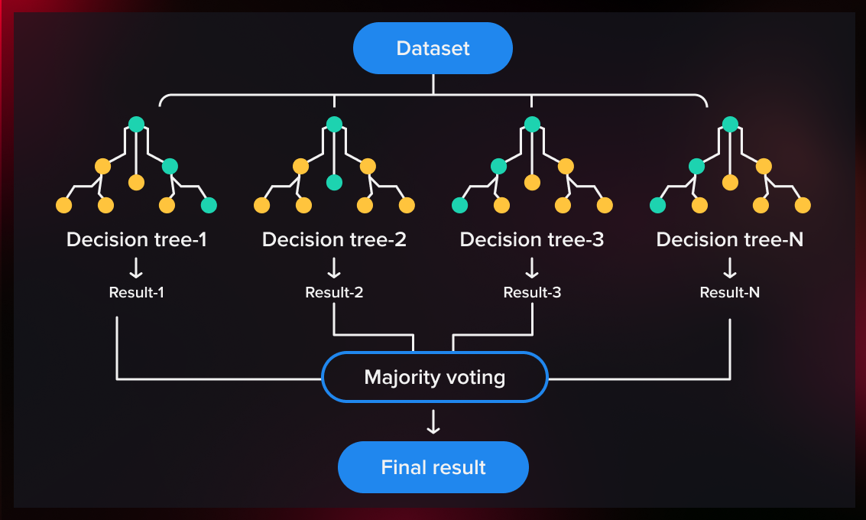
Random forest
5
Random Forest is an ensemble learning method that constructs multiple decision trees during training
Each tree is built using a random subset of features and a bootstrap sample of the training data
Final prediction is made by averaging the predictions of all the individual trees (for regression) or using the mode of the classes (for classification)
Known for its ability to reduce overfitting and improve generalization, making it a popular choice for various machine learning tasks
Versatile, handles large datasets, maintains accuracy with missing data, and estimates feature importance

Slide 6

FRAUD DETECTION SYSTEM
Uses data analysis, machine learning, and pattern recognition to identify and prevent fraudulent activities
These systems are crucial for industries such as banking, insurance, e-commerce, and healthcare to protect against financial losses and maintain trust with customers
By analyzing transaction data and user behavior, fraud detection systems can detect anomalies and potential fraud
Continuous adaptation and learning enable these systems to evolve and improve their effectiveness in detecting new fraud patterns and technologies

Slide 7

FEATURE EXTRACTION
A crucial step in data analysis which transforms raw data into a more suitable format for further processing
Correlation matrix:
Helps in feature extraction as it provides observations into the relationships between variables in the dataset
It helps detect redundant or irrelevant features that can be removed
Simplifies the model by selecting the most predictive features
Improves model performance and efficiency by reducing complexity
Helps detect multicollinearity, where features are highly correlated, which can adversely affect the model's performance
Guides feature selection process for a more accurate and streamlined model

Slide 8
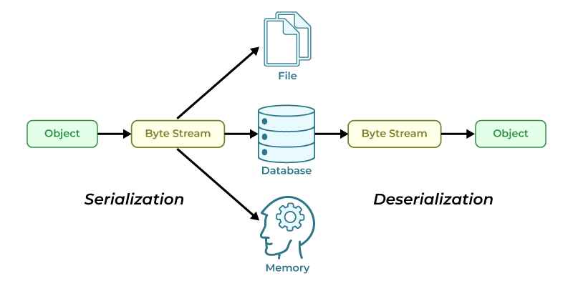
PICKLE MODEL
Pickle is a Python module used for serializing and deserializing Python objects
It allows objects to be converted into a byte stream for storage or transmission
Pickle can be used to save machine learning models for later use without retraining
It provides a convenient way to store complex data structures in Python
Pickle is widely used in Python for saving and loading data objects in various applications

Slide 9

FLASK
Flask is a lightweight web application framework for Python
It allows you to quickly build web applications with Python
Flask is easy to learn and use, making it ideal for beginners and small projects
It provides tools and libraries for tasks such as URL routing, template rendering, and handling HTTP requests
Flask is widely used for building web APIs, websites, and web applications

Slide 10

User interface (ui)
Provides insights into credit card defaulters based on their respective attributes
Allows users to explore and analyze data related to credit card defaultees, such as demographics, transaction history, and payment behavior
Presents this information in an easy-to-understand format, using charts, graphs, and tables to visualize the data
Users can interact with the UI to filter and sort the data, gaining valuable insights into the characteristics of credit card defaultees

Slide 11

DEMONSTRATION
11

Slide 12
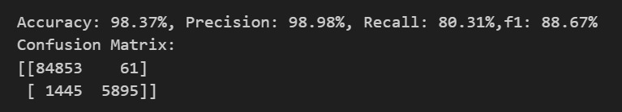
RESULTS
After analyzing various algorithms, the credit card fraud detection model achieves remarkable accuracy and precision, surpassing 90%
The Random Forest algorithm stands out as the most accurate option for this application, ensuring robust performance.

Slide 13
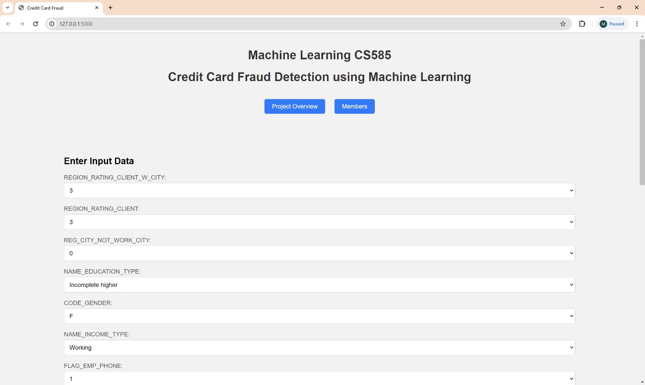

Slide 14
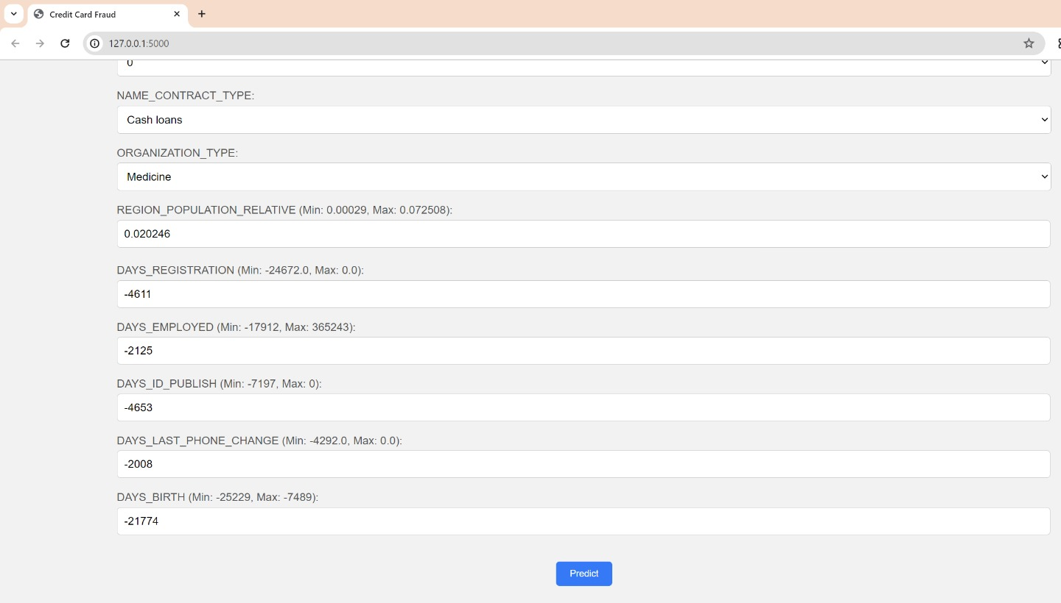

Slide 15
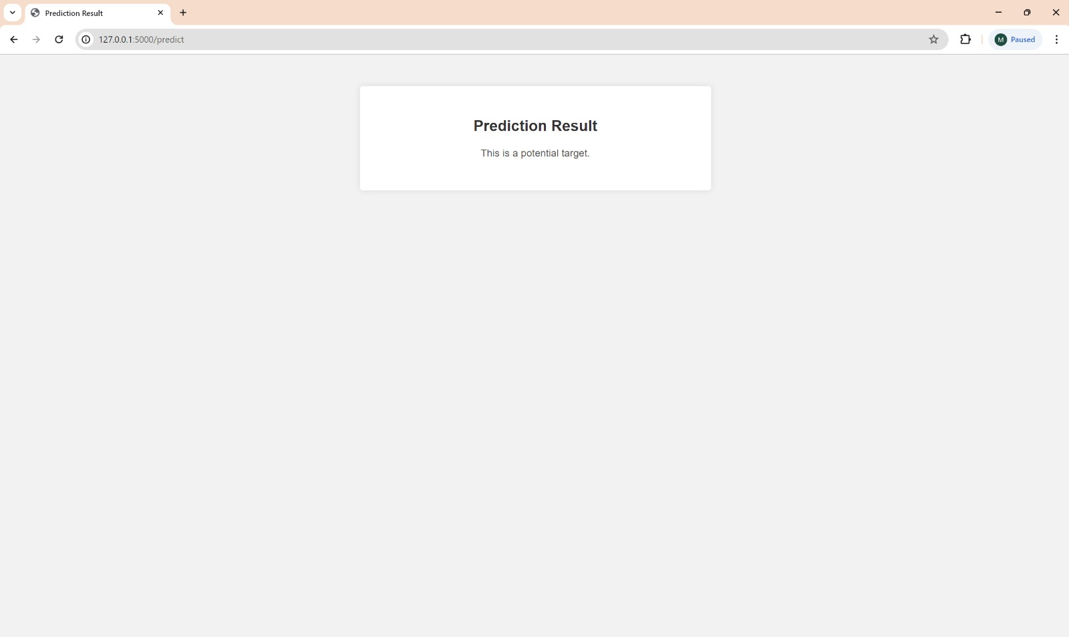

Slide 16
Thank you
Manavkumar Patel
Nitesha Paatil

